Slide 1



Integrating the Envoy gRPC API into a Dynamic Service Discovery Platform
Mihai Todor
28.05.2020

Slide 2
About me
Senior Software Engineer at Cogito
Focused on highly-scalable distributed systems and Go
Find me on:
Linkedin: https://www.linkedin.com/in/mtodor
Twitter: @MihaiTodor

Slide 3





Service meshes
Infrastructure layer of an enterprise service cluster
Handle service-to-service communication
Reliability
Security
Observability
Management
Examples:
Istio https://istio.io/
Consul https://www.consul.io/
Linkerd https://linkerd.io/
Kuma https://kuma.io/
Maesh https://containo.us/maesh/

Slide 4
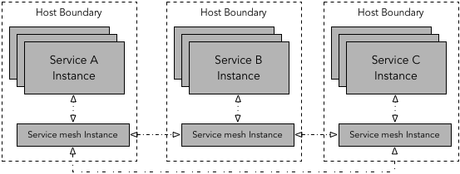
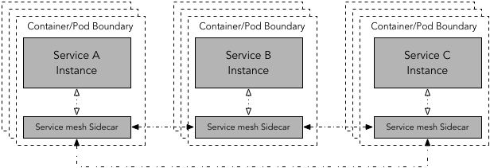
Service mesh deployment models
Per-host proxy deployment
Sidecar proxy deployment
Via: https://www.abhishek-tiwari.com/a-sidecar-for-your-service-mesh/

Slide 5
Sidecar https://github.com/Nitro/sidecar
Dynamic service discovery platform
Per-host proxy via either HAProxy (through haproxy-api) or Envoy
Docker native
Gossip-based communication between hosts via Memberlist
Health checks (HTTP or external)
Has been used in production on Apache Mesos clusters

Slide 6
Sidecar history
Karl Matthias started developing it at New Relic back in 2015
I’ll have to ask him what “bosun” stands for :)
He deployed a fully-working version in production at Nitro in 2016 on top of a Mesos cluster, initially using HAProxy as a sidecar proxy
Envoy support was added afterwards via the now deprecated Envoy REST API
He continues to use it in production at Community and maintain it
I recently integrated the Envoy go-control-plane to enable support for the Envoy gRPC API
I used the Aggregated Discovery Service, which is part of the xDS gRPC-based V2 API

Slide 7
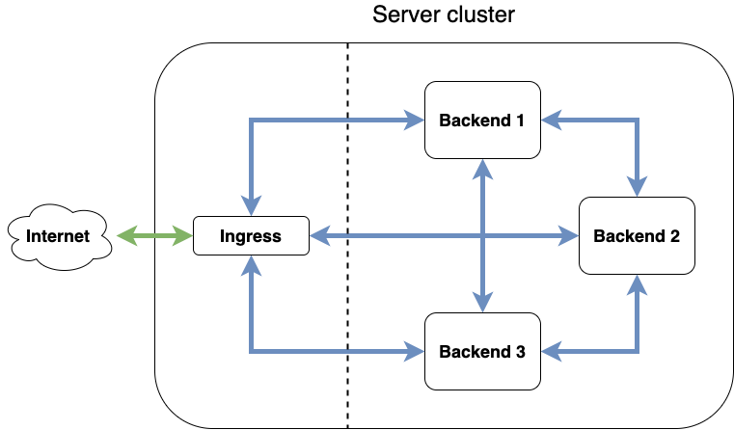
Architecture

Slide 8
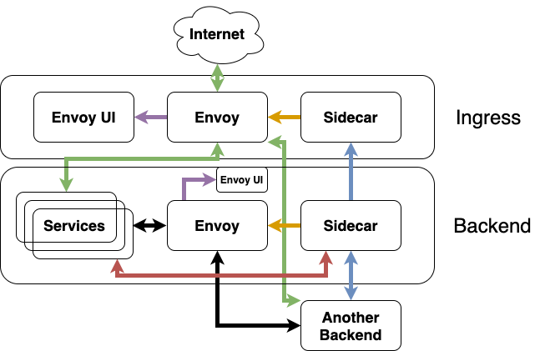
Detail
Ingress traffic
Inter-service traffic
Sidecar gossip
Sidecar Docker discovery
Sidecar health checks
Sidecar -> Envoy updates
Envoy UI updates

Slide 9
Demo
Simulated cluster on local laptop using Docker-in-Docker aka DinD
One ingress container running
Sidecar in listener mode
Envoy with static listeners and ADS
Envoy UI
Three backend containers (or more) running
Sidecar
Envoy with ADS
Envoy UI
Three WhoAmI containers
two HTTP services
one TCP service

Slide 10
Envoy APIs
v1 REST-JSON xDS API (deprecated and no longer supported)
v2 xDS API (deprecated, end-of-life EOY 2020)
Beyond...

Slide 11
Push vs Pull based APIs
The Sidecar and Envoy states are designed to be eventually consistent
For the V1 API, Envoy was configured to pull the whole state from Sidecar every 4 seconds
For the V2 API, Sidecar checks its internal state for updates every second and pushes the updated state to Envoy if needed
Alternatively, it could send an update on each state update event, but this has potential issues:
Spurious updates
Potentially missed updates

Slide 12
State updates
Can be expensive to send the whole state on each update in a large cluster
We can leverage the Envoy Incremental xDS API to send partial updates
Eventual consistency considerations
Still work in progress in the Envoy go-control-plane

Slide 13
Envoy go-control-plane ingredients
xDS server: github.com/envoyproxy/go-control-plane/pkg/server
gRPC server: google.golang.org/grpc
github.com/envoyproxy/go-control-plane/envoy/service/discovery/v2
RegisterAggregatedDiscoveryServiceServer to connect the gRPC and xDS servers
Resource cache: github.com/envoyproxy/go-control-plane/pkg/cache
SetSnapshot instructs Envoy that it needs to fetch the updated resources
Sets Envoy listeners, clusters and other resources
Requires a new version
The node parameter needs to match the value passed via `--service-node` to Envoy
Envoy validates clusters by default for the HTTPConnectionManager-based listeners
If enabled, clusters need to be added before adding listeners that depend on them; See the eventual consistency considerations
Can be disabled via the validate_clusters parameter of the RouteConfiguration

Slide 14
Testing strategies
Mock the Envoy go-control-plane… Uh-oh
Mock Envoy itself by creating a dummy gRPC client
Nonces need to be passed around correctly
Go makes it trivial to inherit all the data members and methods of a struct and override desired methods as needed
Enable various assertions during concurrent workflow using a channel-based blocking state machine

Slide 15
Thank you!
Please let me know if you have any questions ☺

